Slide 1



Slide 2
Autonomous System

Slide 3
RULES
  No side talks
  Phones are in silent mode
  Questions after each slide
  Take permission before leaving
  There will be a break during the session if you want to eat or drink
  Make sure to take notes about what is discussed

Slide 4
Session 4
“SLAM”

Slide 5
About the instructor
Name : Yousef Mohamed Asal
Mechatronics Level 200
Autonomous Subteam Member 2023

Slide 6
Agenda
Introduction To SLAM
Workflow
Sensor fusion
Mapping
Break
Localization
Loop Closure & Optimization
Algorithms
Challenges
Applications

Slide 7
SLAM
(Simultaneous Localization and Mapping)

Slide 8
Introduction to SLAM
Definition : SLAM (simultaneous localization and mapping) is a method used for autonomous vehicles that lets you build a map and localize your vehicle in that map at the same time
SLAM is difficult — it suffers from the “chicken or egg problem.” In order to accurately localize, we need good maps, but to have good maps, we need to accurately localize
Importance : SLAM is crucial in autonomous systems for precise navigation, real-time adaptation to dynamic environments, and the creation of detailed maps, enhancing safety and efficiency

Slide 9
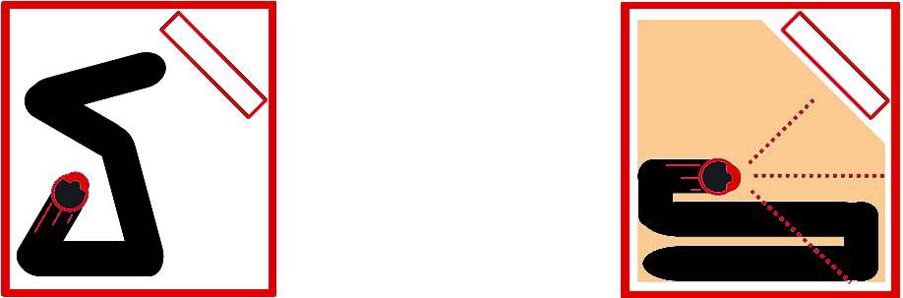
SLAM Examples
Without SLAM
Cleaning Randomly
With SLAM
Cleaning while understanding the room layout

Slide 10
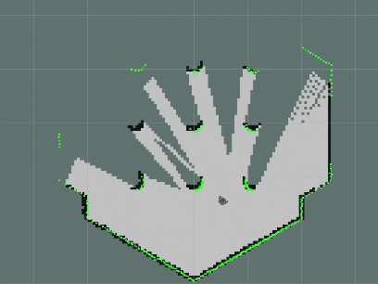
SLAM Examples

Slide 11

Workflow of SLAM
Data Acquisition
&
Feature Extraction
Sensor Fusion
Mapping
Localization
Loop Closure
&
Optimization

Slide 12
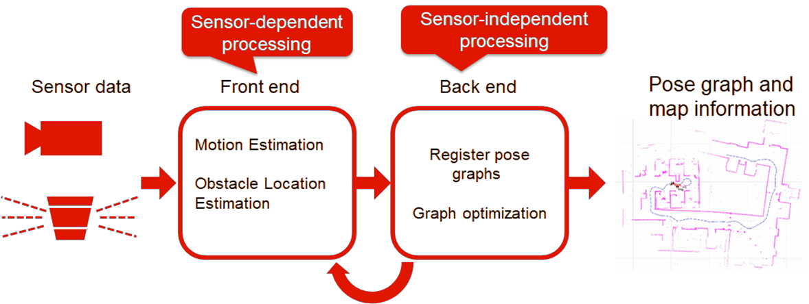
SLAM Flow chart

Slide 13
Data Acquisition & Feature Extraction
Data Acquisition : Data acquisition is the initial step in SLAM where sensors collect information about the robot's surroundings and its own movements
Feature Extraction : Feature extraction is a critical step in SLAM where distinctive and easily trackable points or features are identified within the sensor data. These features serve as reference points for mapping and localization.

Slide 14
Sensor Fusion
Sensor fusion allows for the combination of data from multiple sensors to reduce errors and improve the overall accuracy of pose estimation (robot localization) and mapping.
Using multiple sensors makes the SLAM system more robust to sensor failures or limitations in specific situations
Each sensor has its own uncertainty or noise associated with its measurements. Sensor fusion techniques aim to model and manage this uncertainty

Slide 15
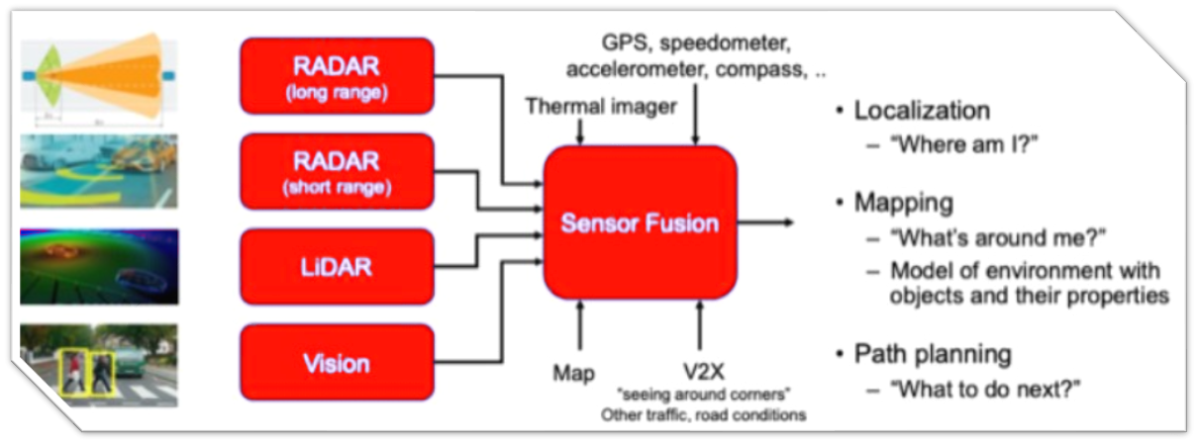
Sensor Fusion

Slide 16
Mapping
Mapping is a core component of the SLAM process. It involves creating a representation of the robot's environment, typically in the form of a map
Mapping is crucial because it provides the robot with spatial awareness, allowing it to navigate, avoid obstacles, and make informed decisions
In SLAM, the map is updated in real-time as the robot explores the environment. As new sensor data becomes available, it's incorporated into the map, allowing the robot to adapt to changes in the environment.

Slide 17
Map Representation
Occupancy Grid Map : A grid-based representation where each cell indicates whether it is occupied, free, or unknown. This type of map is often used for 2D mapping.
Point Cloud Map: A collection of 3D points representing the environment's surfaces. It's commonly used in 3D mapping, especially with lidar sensors.
Feature-Based Map: This type of map represents distinctive features in the environment, such as key points, landmarks, or objects of interest. Feature-based maps are prevalent in visual SLAM.

Slide 18
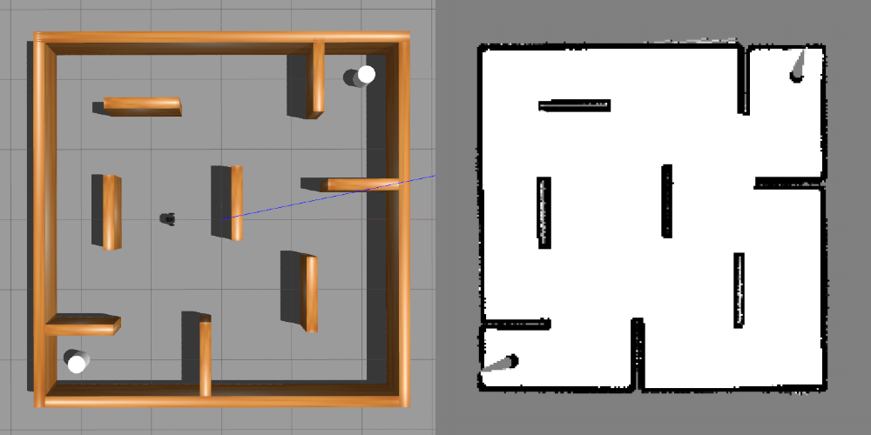
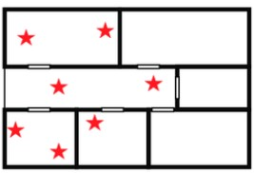
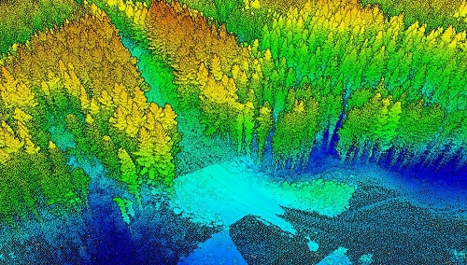
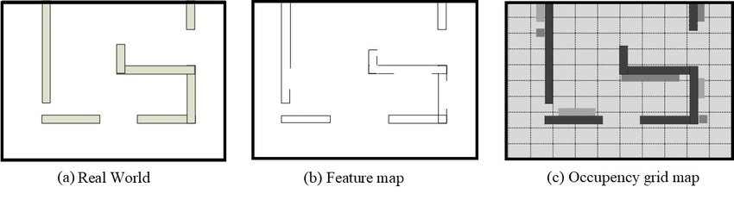
Map Representation
Occupancy grid
Feature based
Point cloud

Slide 19
Types of Mapping
Static Mapping: In scenarios where the environment is assumed to be static (no changes occur over time), the mapping process focuses on building an accurate and static representation of the surroundings.
Dynamic Mapping: Dynamic mapping considers environments with moving objects or changes over time. It must distinguish between static and dynamic elements in the map to support navigation

Slide 20
Localization
Localization is the task of determining the precise position and orientation (pose) of a robot or autonomous system within its known or unknown environment
Localization is crucial for enabling the robot to navigate effectively and make informed decisions.
Localization is a continuous process that updates the robot's estimated pose in real-time as it moves through the environment. This updating occurs iteratively with the arrival of new sensor data.

Slide 21
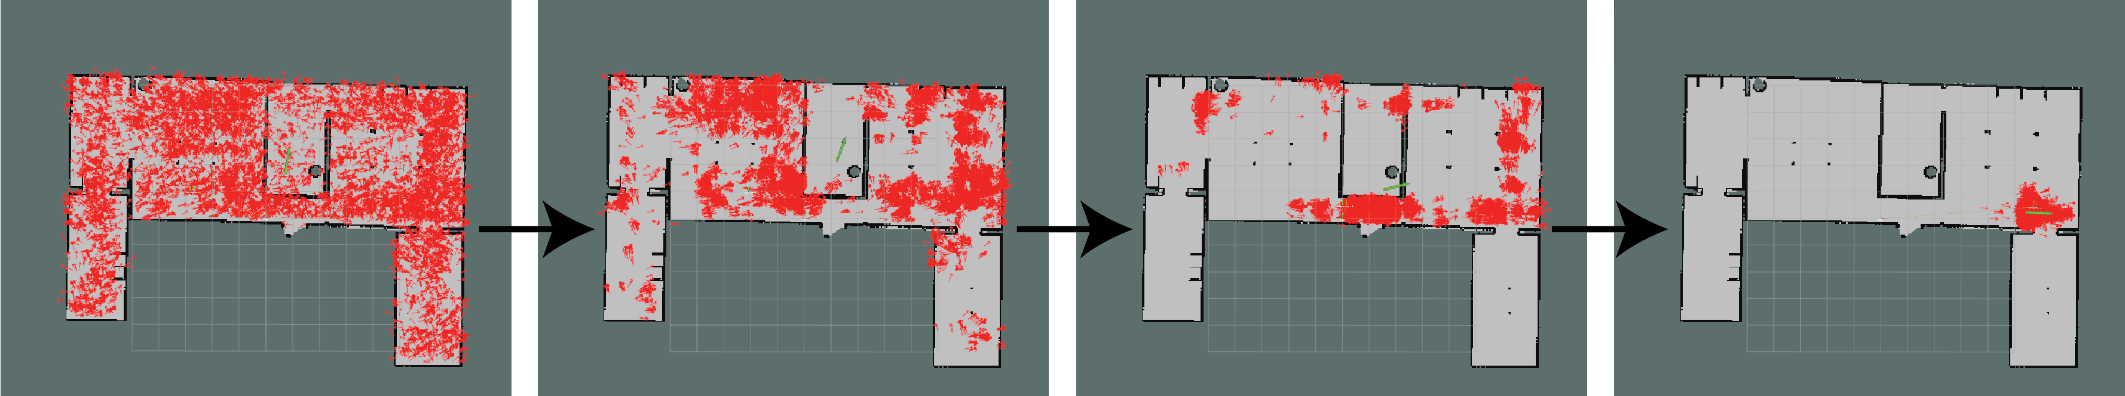
Types of Localization in SLAM
Global Localization: In global localization, the robot starts with little to no knowledge of its initial position within the environment. The goal is to estimate the robot's pose while simultaneously mapping the environment. Particle filters, such as Monte Carlo Localization (MCL), are often used for global localization.

Slide 22
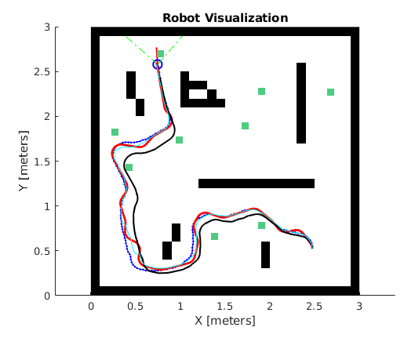
Types of Localization in SLAM
Local Localization: Local localization assumes that the robot has an approximate initial pose estimate. The task is to refine this estimate as the robot navigates. Kalman filters, extended Kalman filters (EKF), and iterative closest point (ICP) algorithms are used for local localization.

Slide 23
Loop Closure & Optimization
The primary goal of loop closure is to correct any accumulated errors in the map and pose estimates, thereby ensuring the overall consistency and accuracy of the SLAM system
loop closure detection and optimization are critical components of SLAM that work together to maintain accuracy and reliability in mapping and localization
Loop closure identifies revisited locations and inconsistencies, while optimization adjusts pose estimates and map features to align with sensor data and minimize errors.

Slide 24
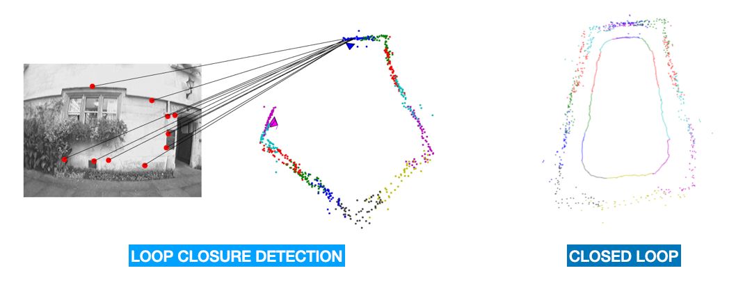
Loop Closure
Detection
Correction
Loop Constraints
Graph Representation

Slide 25
Optimization
Graph-Based Optimization
Bundle Adjustment
Nonlinear Optimization

Slide 26
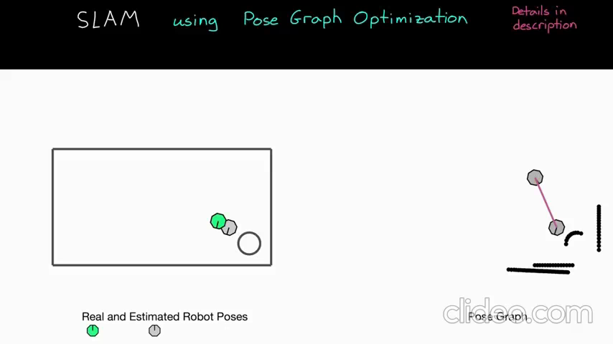
Loop Closure

Slide 27
SLAM Algorithms
EKF-SLAM: Uses Extended Kalman Filter, suitable for small to medium-sized environments.
FastSLAM: Employs particle filters for mapping with many landmarks.
Graph-Based SLAM: Represents the problem as a graph, flexible and extensible.
ORB-SLAM: Visual SLAM for RGB-D or monocular cameras, real-time performance.
Hector SLAM: 2D lidar-based, for indoor and dynamic environments.
Google Cartographer: Supports 2D and 3D mapping, versatile in indoor and outdoor scenarios.
LiDAR-based SLAM: Utilizes lidar scans for high accuracy in various environments.
LSD-SLAM: Direct visual SLAM, excels in large-scale and featureless environments.

Slide 28
Selecting the Appropriate SLAM Algorithm
Consider the sensor suite: Choose algorithms based on available sensors (e.g., cameras, lidar).
Environment complexity: Assess the complexity of the mapping environment (e.g., indoor, outdoor, feature-rich, featureless).
Real-time requirements: Ensure the chosen algorithm meets real-time performance needs.
Computational resources: Consider the available computing power (e.g., CPU, GPU).
Cost constraints: Evaluate sensor costs and budget limitations.
Robustness: Choose algorithms that can handle dynamic obstacles or changing lighting conditions effectively.

Slide 29
Challenges In SLAM
Sensor Noise: Inherent sensor noise can introduce errors into the robot's pose and map.
Drift: Cumulative errors in pose estimation over time, known as drift, can lead to inaccuracies.
Loop Closure: Correctly detecting and handling loop closures is crucial for map consistency.
Dynamic Environments: Moving objects or changes in the environment can confuse SLAM algorithms.
Computational Resources: SLAM can be computationally intensive, challenging real-time processing.
Data Association: Associating sensor measurements with the correct features can be difficult.
Lighting Conditions: Variations in lighting conditions can affect the performance of visual-based SLAM algorithms

Slide 30
SLAM Applications
Autonomous Vehicles: Self-driving cars and drones for safe and precise navigation.
Robotics: Autonomous robots for tasks in various industries.
Augmented Reality (AR): Enhancing real-world experiences with virtual information.
Indoor Navigation: Helping people navigate large indoor spaces.
Warehousing and Logistics: Efficient management of inventory and automation.
Mining and Exploration: Navigating complex and hazardous terrains.
Search and Rescue: Locating survivors in disaster-stricken areas.
Underwater Exploration: Submersibles and remotely operated vehicles (ROVs) use SLAM to navigate and map the ocean floor.

Slide 31
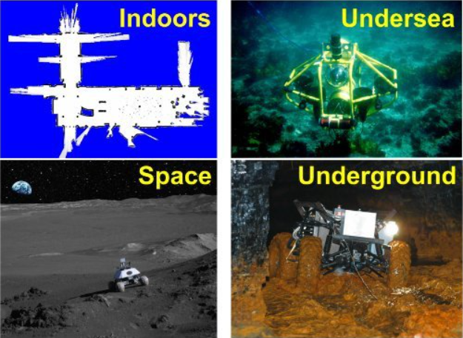
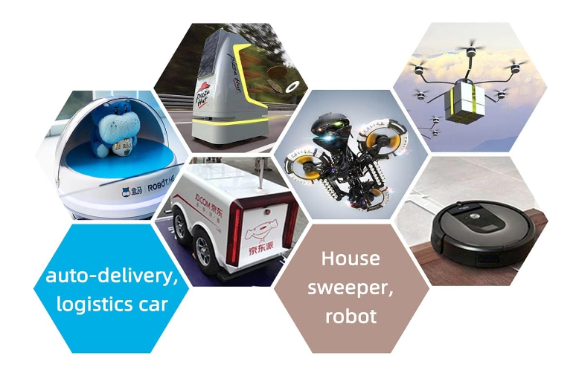
SLAM Applications

Slide 32
Future Trends in SLAM
5G Integration
Edge Computing
Multi-Modal Sensing
AI and Deep Learning
Hardware Miniaturization
Collaborative Mapping

Slide 33
Q & A

Slide 34
Thank You

